Slide 1
Module 10: Animations in React
SER 423

Slide 2
Making Animations
Last time we looked at how both Android and iOS handle animations and some of the basic ways to make them happen
Because of the differences in the platforms, react has a challenge when it comes to making a single solution for both systems
Currently, animations are processed on the JavaScript thread, but they plan to move it to the native thread in the future
In any case, they have promised to continue the current API so there will be no breaking changes as they make the move
The current package to use is called Animated
  There are of course others, but this is the one that comes with react
We can use another package called Easing to handle calculating movement

Slide 3
Making a Simple Animation
We first need to get Animated.Value() which will handle the animation values for each frame
We should do this within componentWillMount to get it set up right away
We can then define a function to start the animation and call it from componentDidMount
  These are the two primary lifecycle hooks to use with animation
Within our function, we work with Animated.timing() to set up the animation
This takes that animated value from before as well as our own parameters
  Which we’ll look at in a moment
Then we call start, which can take a callback function
  Pass the same function in to create a looping animation!
Finally, in render we add an Animated.Image to our View and update it’s properties based on that animatedValue from before

Slide 4
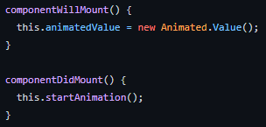
Lifecycle Methods

Slide 5
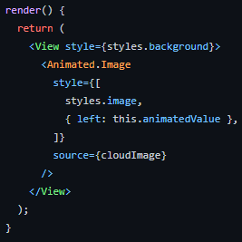
Render with the Animated.Image

Slide 6
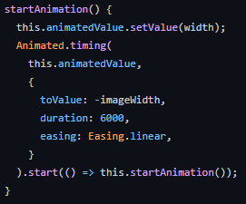
The Animation Function

Slide 7
Showing Multiple Animations
Displaying multiple animations might seem tricky given that we have one shared animatedValue instance
However it is not too hard to set this up because we can reuse these values and just interpolate them for the multiple animations
  Based upon other points (other animations) we can calculate where this animation should be
We can even use all of the same code we just looked at
Where we make a change is in render
  The animation function is running continuously since we started it in the lifecycle hook
All we do here is take the animatedValue and interpolate it for each animation
  This might sound complicated but animatedValue can do it for us!
We then save the results of all of these an apply the proper one to each animation in the View

Slide 8
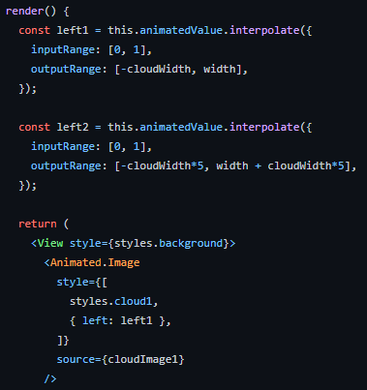
Updated Render

Slide 9
End of Animations in React
That’s all for Module 10!

